Slide 1
Personality Analysis for Marketing Campaign
Significantly Different

Slide 2
The Team

Slide 3

The Team
Osama Lubbadeh
Project Manager
Hala Ibrahim Senior GIS Technical Officer
Firstname Lastname
Profession
Firstname Lastname
Profession

Slide 4
Problem Definition

Slide 6
Problem Definition
Customer Personality Analysis gives insights into target audience by breaking down or segment audience into groups based chosen characteristics. Target is: to perform clustering to summarize customer segments.
The Data was provided from Kaggle.com
Building a segment based strategy is the key to customer retention and increased sales.

Slide 7
2. Exploratory Data Analysis

Slide 8
2. Exploratory Data Analysis
Data problems: Missing Data, outliers, a lot of features engineering
Patterns emerged from EDA
Techniques used to extract insight (i.e, EDA and Data Engineering)
The Before and after of the EDA and Data Engineering

Slide 9
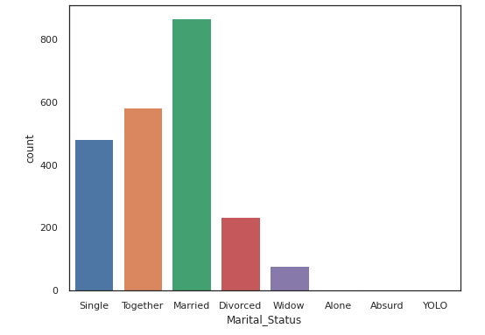
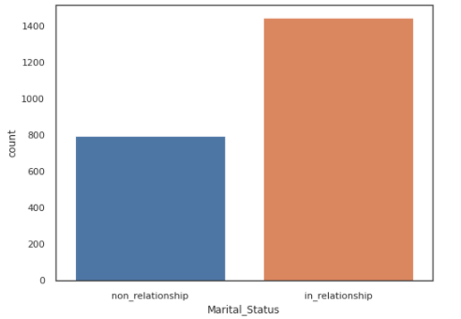
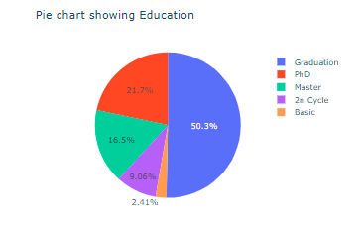
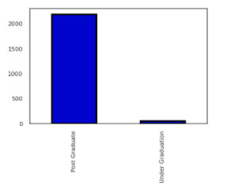
EDA and Data Engineering

Slide 10
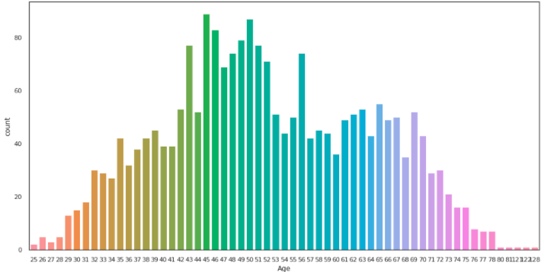
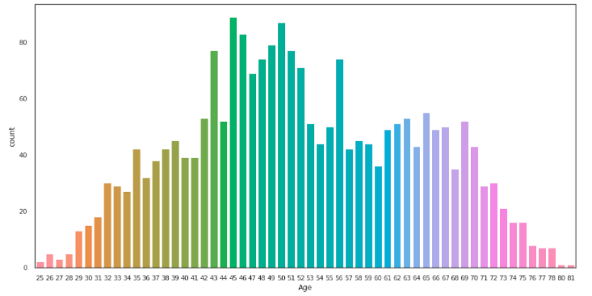
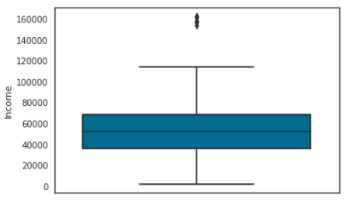
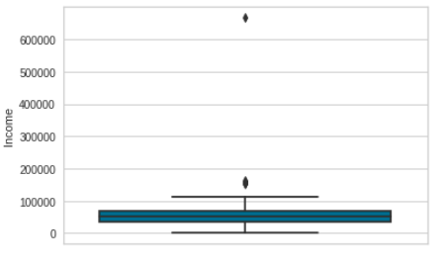
EDA and Data Engineering
Remove Outliers

Slide 11
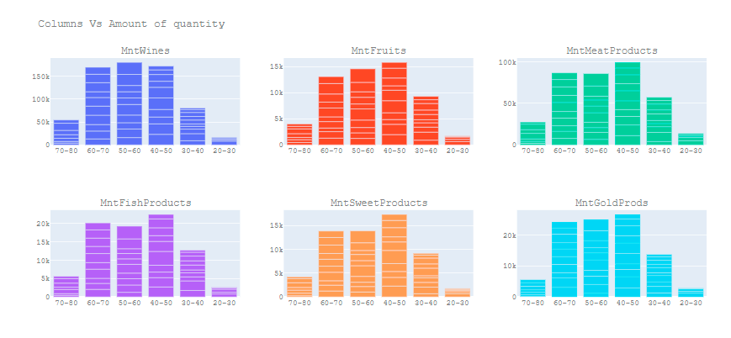
Patterns emerged from EDA ( Age Vs amount purchased of each item)

Slide 12
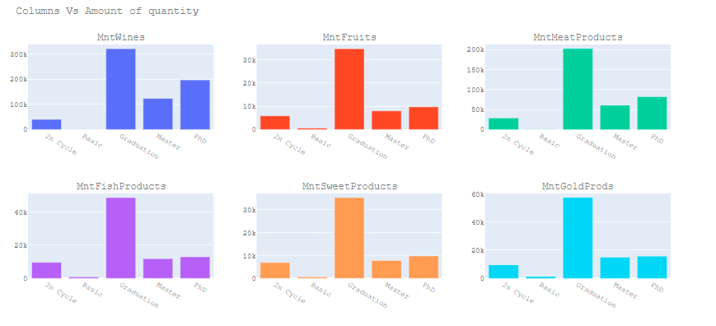
Patterns emerged from EDA ( Education Vs amount purchased of each item)

Slide 13
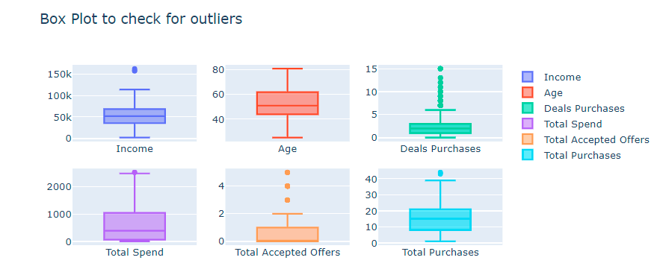
EDA After Data cleaning

Slide 14
3. The Machine Learning Model

Slide 15
3. The Machine Learning Model
Unsupervised-learning : K-Means- Clustering
The features ( Total Purchases ,Income, Education Marital Status , Num Deals Purchases , Age, Kids, Average Spent Total Accepted Offers, Days is Client) and label (Total Spend)
K-Means-Clustering – offers easy grouping (clustering)
K-means clustering tries to minimize distances within a cluster and maximize the distance between different clusters

Slide 16
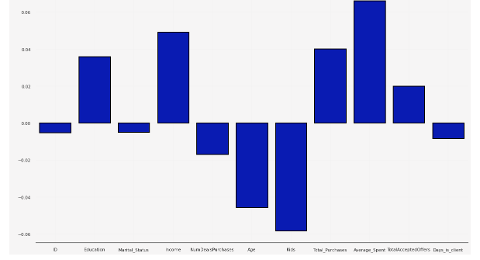
Correlation of Features with Target

Slide 17
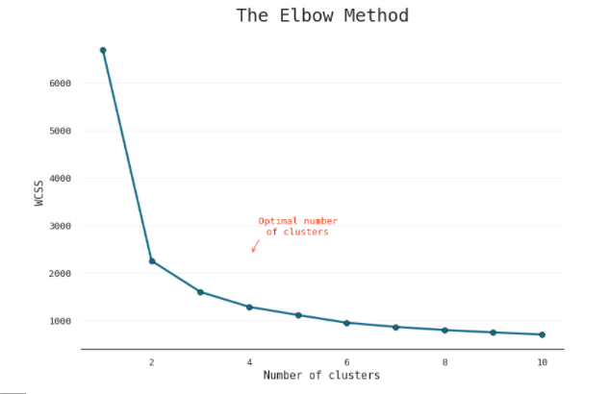
Elbow method to determine the optimal number of clusters

Slide 18
4. Machine Learning Analysis

Slide 19
4. Machine Learning Analysis
In this section, you will talk about the following:
The final metrics of the model
How you trained the model
The hyperparameters used
Other improvements that could be made

Slide 20
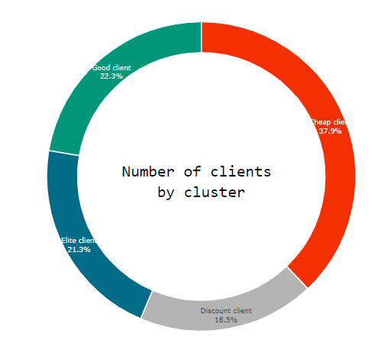
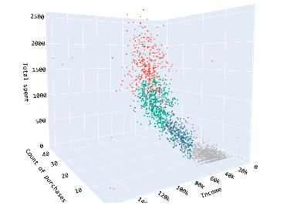
4 Customer clusters

Slide 21
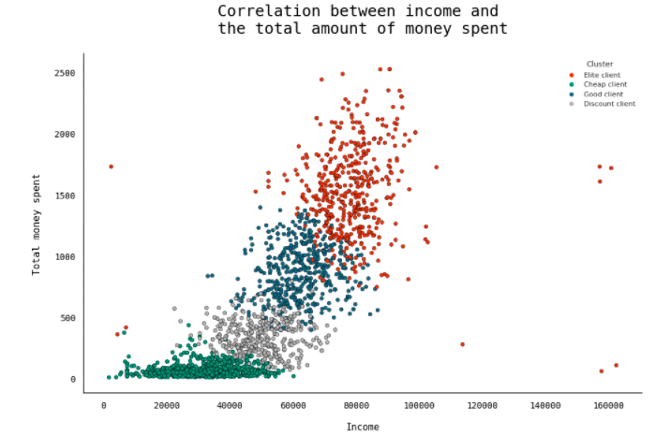
4 Customer clusters

Slide 22
5. Conclusion

Slide 23
5. Conclusion
In this section, you will talk about the following:
The top 3 challenges: Data cleaning, StandardScaler, Model metrics,
The top 3 lessons: Do it yourself-do not wait for others,find a reliable refrence source, ask the right questions
Next steps for your data science career ( complete My previous courses, Do Data science projects, post these projects ( linkedin,github…), create courses, and network.
Any comments you’d like to add!

Slide 24
6. Any Questions from Audience?

